Slide 1


ACCOMDATION FARE PREDICTOR
MSDS696_X70_Data Science Practicum II
Regis University
Dr.Kellen Sorauf
PRESENTED BY
Swapna Emmadishetty

Slide 2

OVERVIEW
The objective of this project is to create a machine learning model that can precisely predict the fare of accomdations based on various characteristics, including the number of bedrooms, bathrooms, area, locality, furnishings, tenants, and facing. The property data dataset, which includes training, testing, and validation datasets, will be used to train the model.

Slide 3

ROAD MAP
Data exploration and cleaning
Data visualisation
Feature Selection and Model training
Model selection
Hyper parameter-tuning and Finalisation

Slide 4
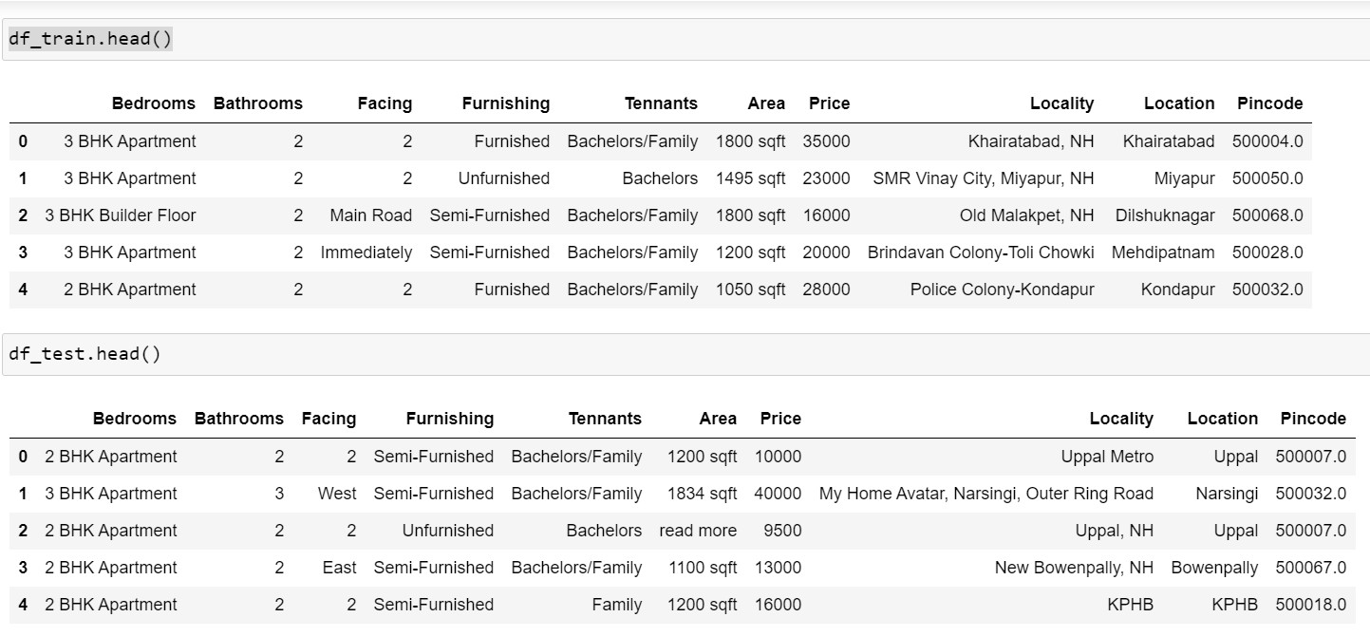
DATASET

Slide 5
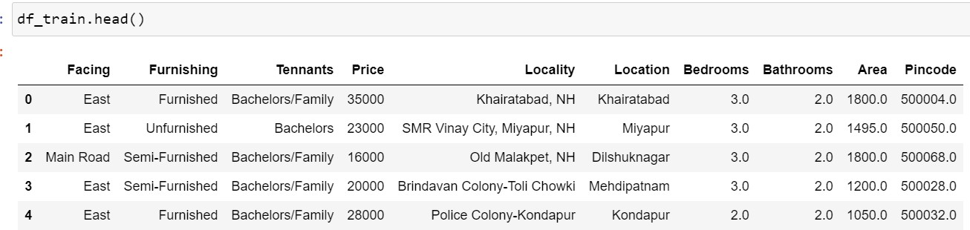
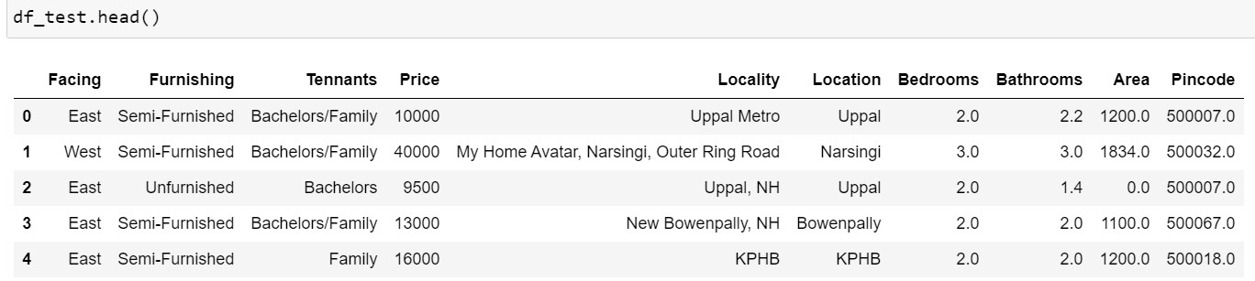
DATASET
After cleaning and pre-processing

Slide 6
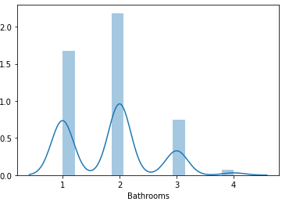
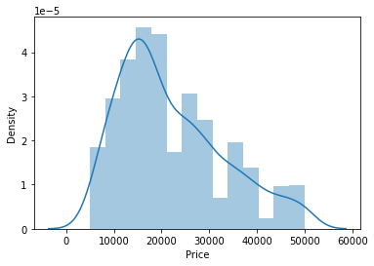
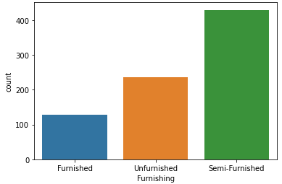
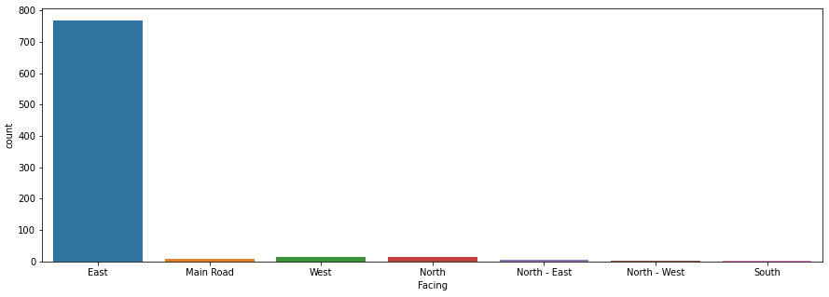
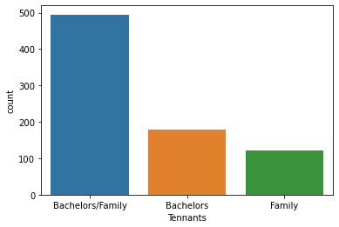
DATA VISUALISATION

Slide 7
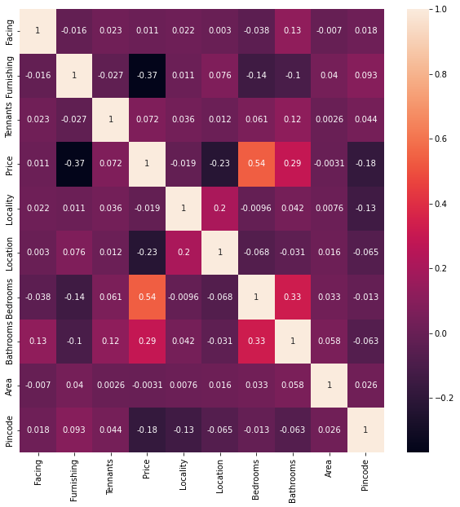
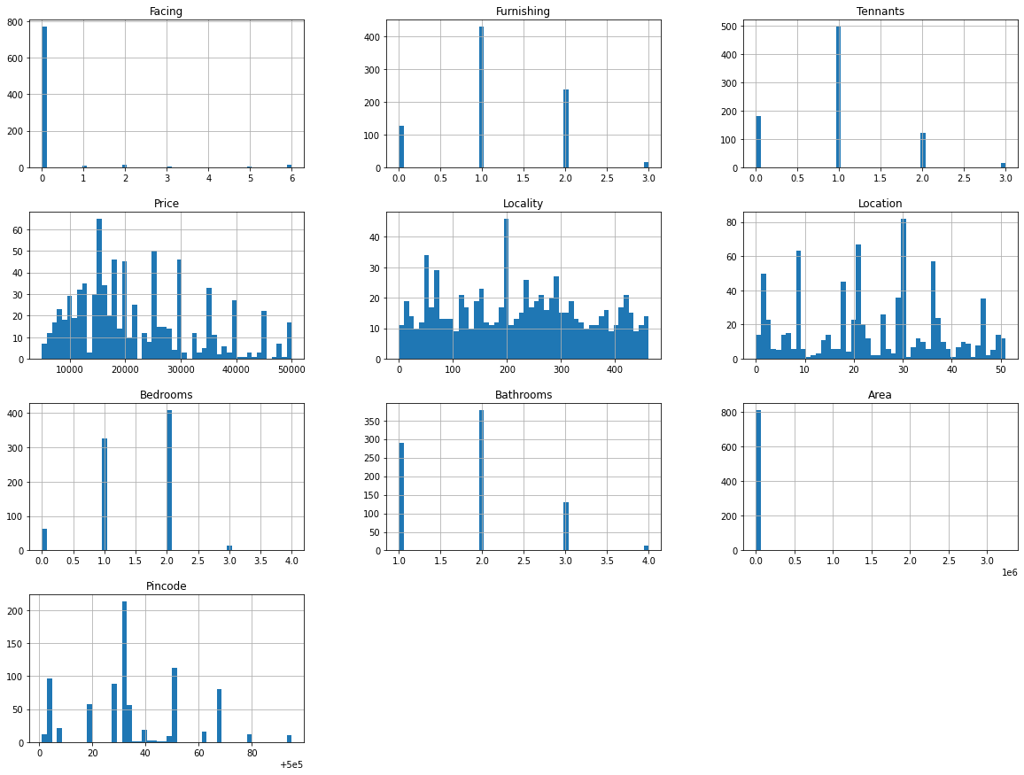
DATA VISUALISATION

Slide 8
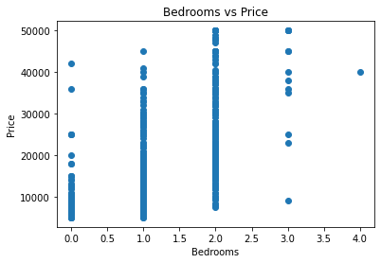
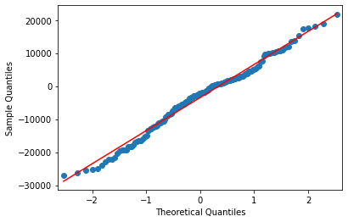
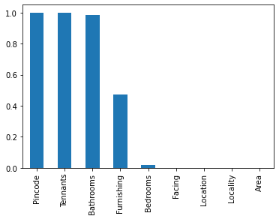
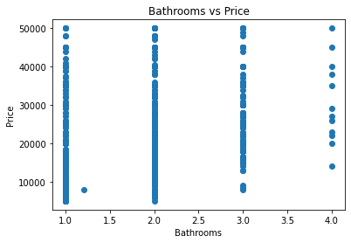
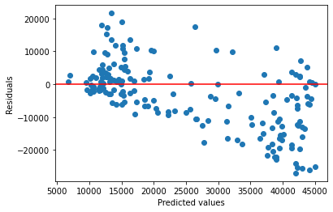
DATA VISUALISATION

Slide 9
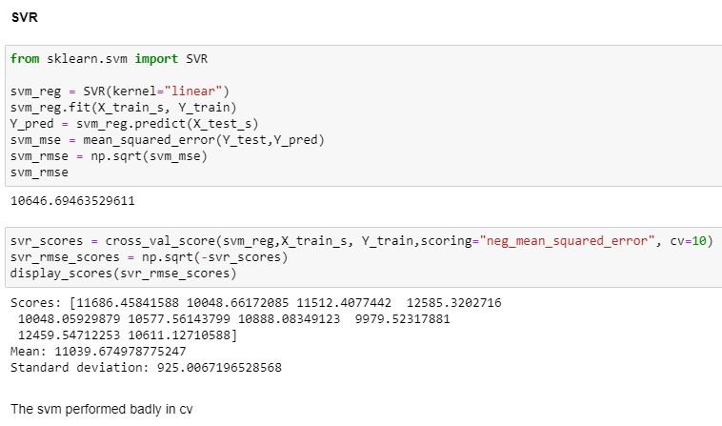
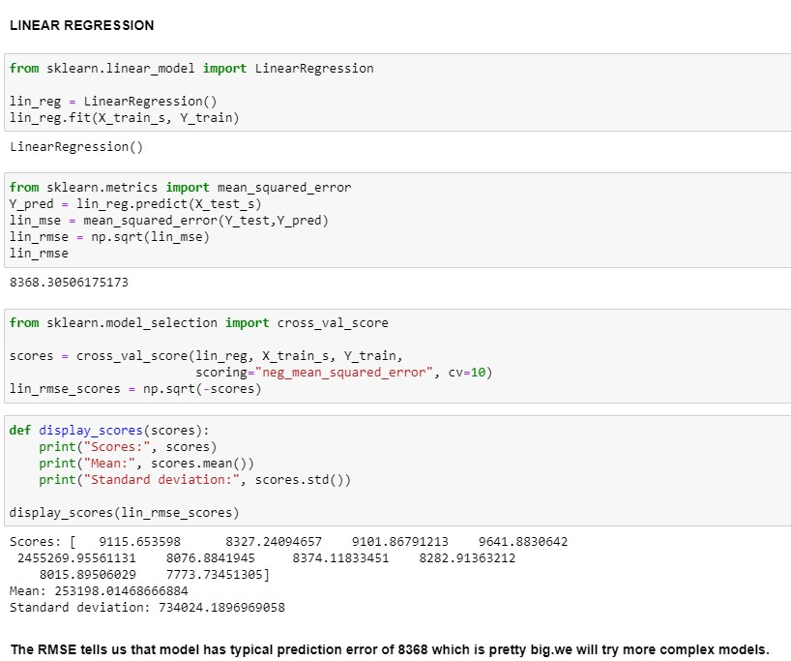
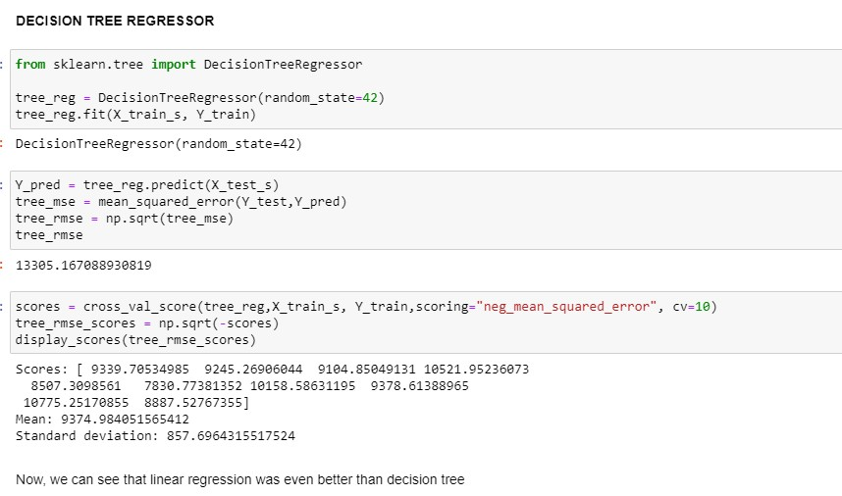
MODEL_TRAINING

Slide 10
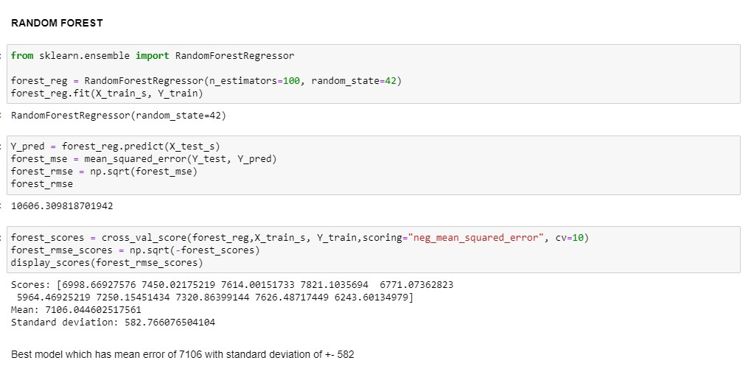
MODEL_TRAINING

Slide 11
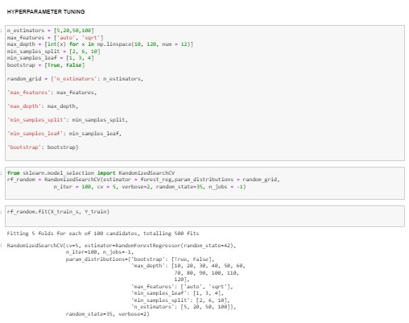
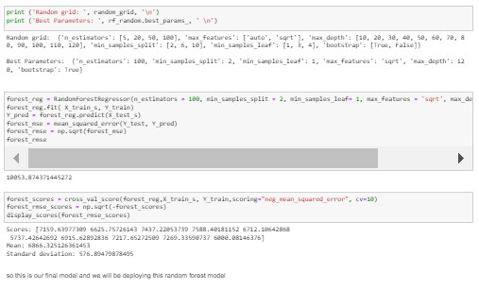
Hyperparameter_Tunning
so this is our final model and we will be deploying this random forest model.

Slide 12
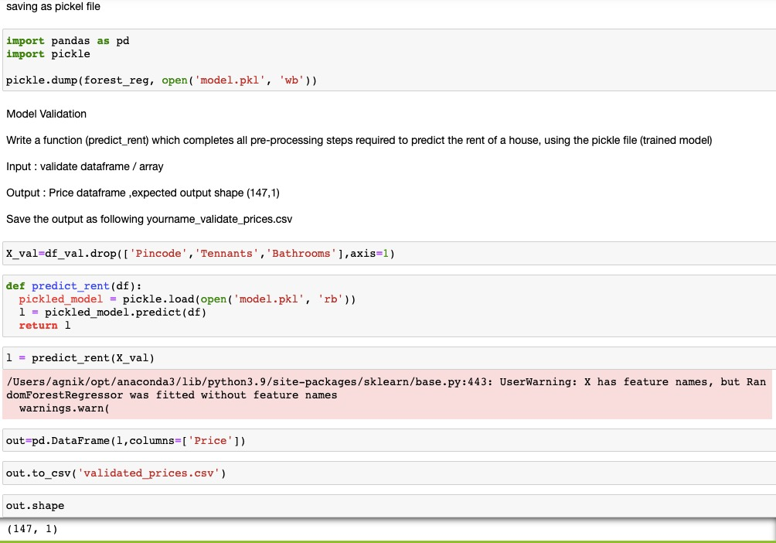
Here, we are saving as a Pickle file where we have Writen a function (predict_rent) which completes all pre- processing steps required to predict the rent of a house, using the pickle file (trained model) and saved the output as following csv file.

Slide 13


